Slide 1
Multi-Layered Data Classification for Biomarker Discovery
Ellis Patrick
School of Mathematics and Statistics

Slide 2




Collaborators
School of Mathematics and Statistics
Jean Yang (CI)
Samuel Muller (CI)
Funded through ARC
DP130100488
Vertically integrated
statistical modelling in
multi-layered omics
studies

Slide 3


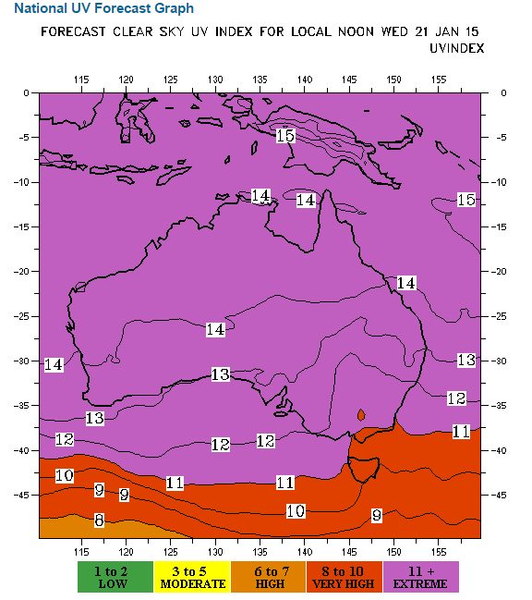
UV index on January 20, 2015
Notes:
The UV index is on a linear scale, if it takes 30 minutes for a sun burn when the index is 6 then someone would burn in 15 minutes when the index is 12.
Sydney has approximately the same latitude as Los Angeles, just under 34º

Slide 4
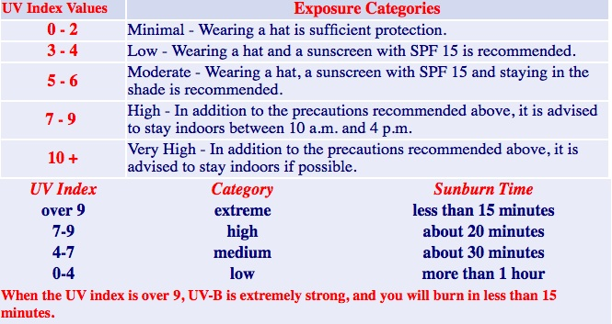
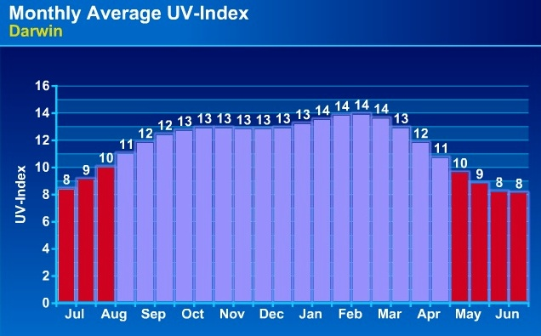
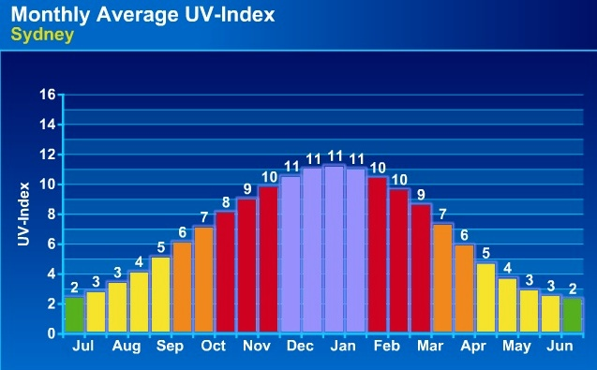
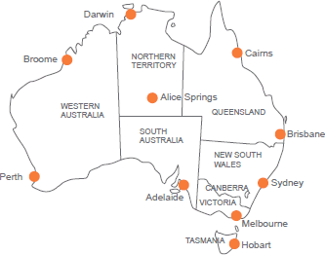
Monthly average UV-Index

Slide 5

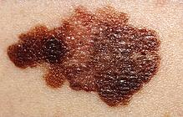
Melanomas
Melanomas are common in a large demographic of the population, especially in Caucasians living in sunny climates.
Of those that metastasize (Stage III), about 40% go on to live cancer free, but another 40% succumb to the disease in less than 1 year.
Samples were obtained from Professor Graham Mann's (third CI) group from the Westmead Institute for Cancer Research and Melanoma Institute, Australia (MIA).
Notes:
In 2010, melanoma of the skin was the 4th most commonly diagnosed cancer in Australia (after prostate, bowel and breast cancer), accounting for 9.8 per cent of all new cancers, excluding non-melanoma skin cancer.
In 2011, there were 1,544 deaths from melanoma of the skin (1,071 men and 473 women), accounting for 3.6 per cent of all cancer deaths in Australia.

Slide 6
Research aims
84 Stage III
Melanoma specimens
New prognostic markers
To determine whether there are significant biomarker and pathway differences between melanomas of good and bad prognosis after resection of nodal metastatic disease;
New therapeutic targets
To identify and validate the principal regulatory pathway abnormalities that characterise metastatic (stage III and IV) melanomas;
To investigate novel genomic drivers of melanoma tumour progression and outcome.
DNA
SNP array / Exome-seq
DNA-seq
RNA
mRNA array / microRNA
RNA-seq
Protein / Metabolic
iTRAQ / MS/MS
Phenotype
Clinical and pathological data
Notes:
I’ve written the specific research aims on this slide but the upshot is that I’m looking for new prognostic markers and new therapeutic targets in stage III melanoma.
So, can cancer systems biology help?

Slide 7
Experimental data Stage III metastatic melanoma
Two survival groups
Poor prognosis Survival < 1 year and died due to melanoma
Good prognosis
Survival ≥ 4 years with no sign of relapse

Slide 8
Experimental data Jayawardana et al (2015; IJCR)
84 Stage III
Melanoma specimens
GP: < 1 year died due to melanoma
PP: > 4 year with no sign of relapse
CPM
omics data
Clinico-pathologic
(n = 48)
BRAF / NRAS
Mutation status
(n = 48)
mRNA expression
(n = 47)
microRNA expression
(n = 45)
Protein (iTRAQ) expression
(n = 33)*
19 variables
2 variables
48802
probes
1347 sets of probes
8397 peptides
Notes:
We have a very rich data set, which has comparably many CPM (clinico-pathologic and mutation) variables and that is rather unusual about our data; here we try to explore that data as good as we can. The first paper on our data was just accepted for publication in the International Journal of Cancer Research.

Slide 9
Main messages
Each data platform (clinical, gene, protein) has its own challenges.
Additive vertical integration is not automatically better.
Error rate hunting.
Interaction effects are difficult to find when p is large.
‘Hard’ and ‘Easy’ classification helps to find interaction terms.
Good clinico-pathogical data is invaluable.

Slide 10
Characteristics of our data
Detailed clinical and pathological data, with mutation status for majority of the patients
“Small” clinical data
Small relative to other cancer types
Large study of fresh tissue samples focusing on Stage III patients
Missing values
Vertical (omics) data integration = more molecular information on the same patients
Contrast to horizontal data integration = more patients with the same genetic information

Slide 11
Challenges in “vertical” integration
Small number of samples
Sample mismatch
Understanding and processing many different platforms
Correlated information from multiple platforms
Unbalanced number of variables between CPM and high throughput omics platforms

Slide 12
Integration
Extreme variable reduction in omics data
Pre-validation (Tibshirani and Efron, 2002)
PCA based methods
CPM data
21 variables
omics
1 combined
variable

Slide 13
Cross validation

Slide 14
5-fold cross validation
Patients
Testing set
Classifier
Prediction error for testing set
Training set
Genes
Patient prediction errors
Training set
Testing set

Slide 15
5-fold cross validation
Patients
Testing set
Classifier
Prediction error for testing set
Training set
Genes
Patient prediction errors
Training set
Testing set

Slide 16
5-fold cross validation
Patients
Testing set
Classifier
Prediction error for testing set
Training set
Genes
Patient prediction errors
Training set
Testing set

Slide 17
5-fold cross validation
Patients
Testing set
Classifier
Prediction error for testing set
Training set
Genes
Patient prediction errors
Training set
Testing set

Slide 18
5-fold cross validation
Patients
Testing set
Classifier
Prediction error for testing set
Training set
Genes
Patient prediction errors
Training set
Testing set

Slide 19
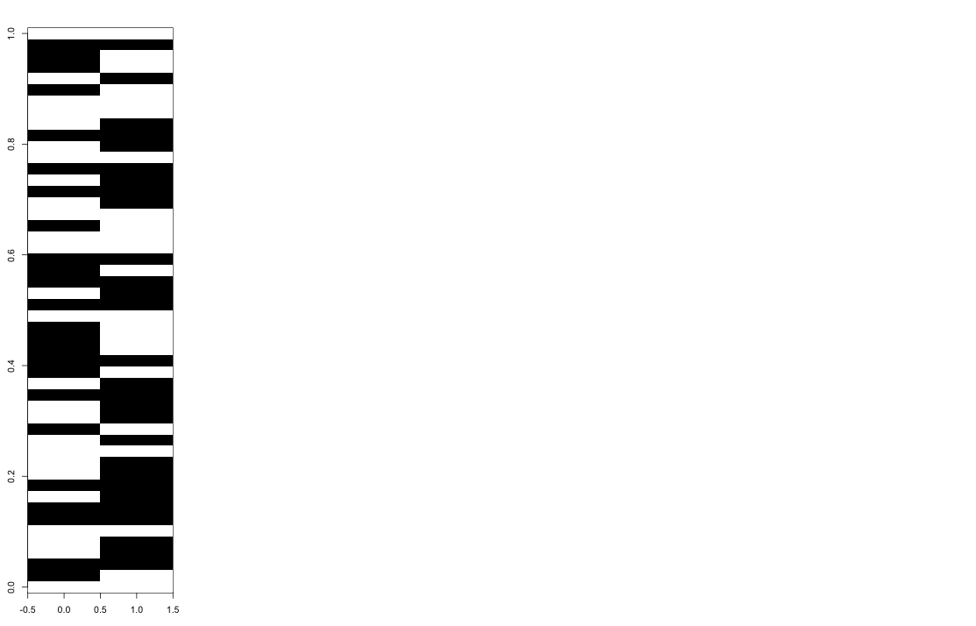
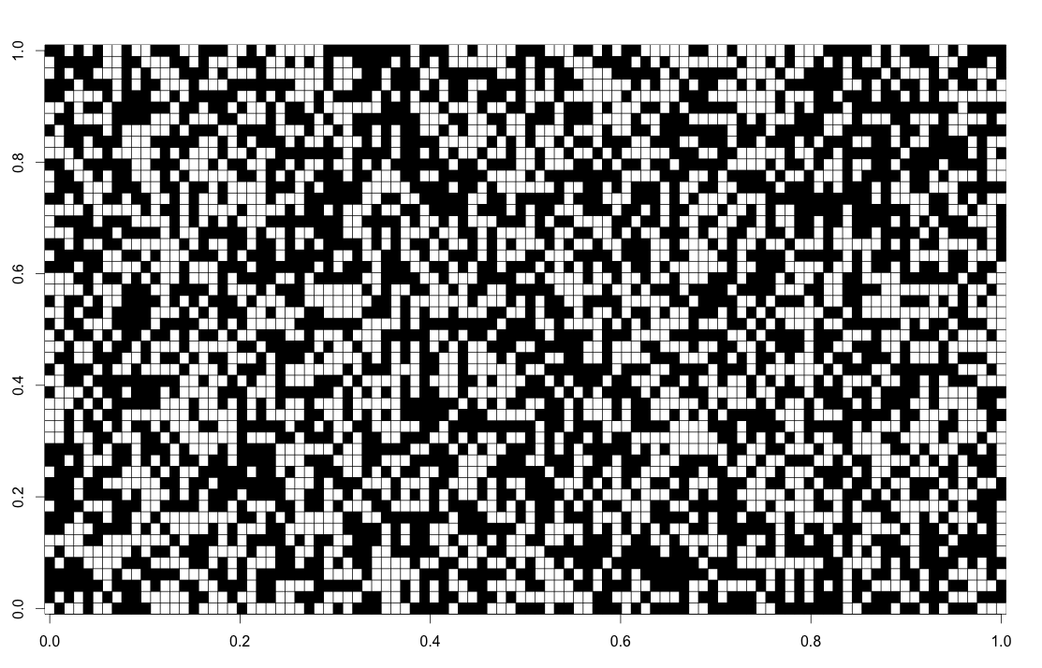
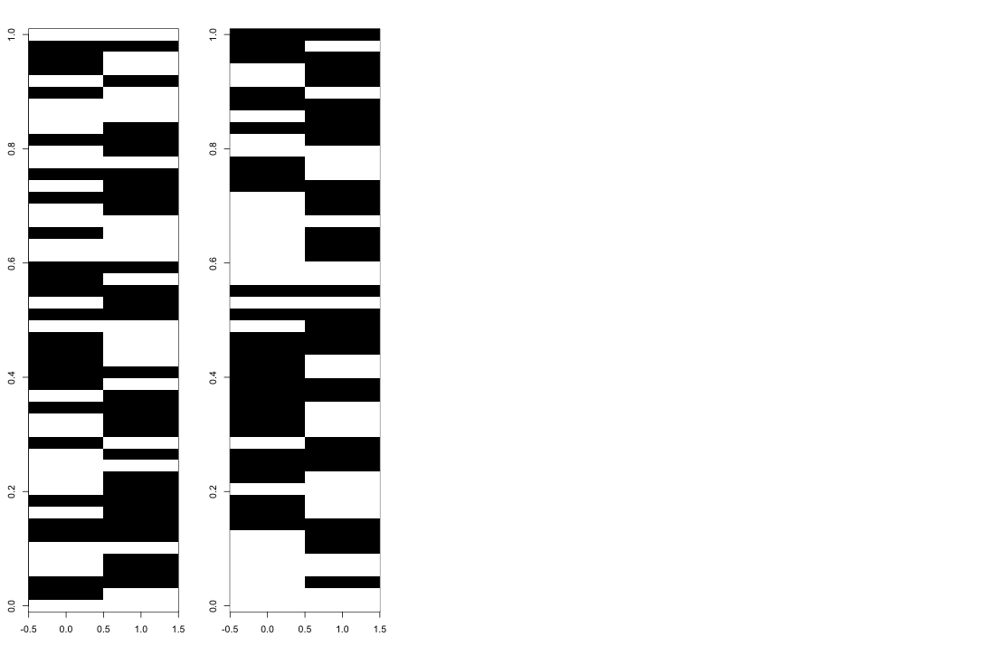
Repeated 5-fold cross validation
resamples
Patients
resample
5-fold CV
Patients
Patients
5-fold CV
Genes
100 resamples
5-fold CV
Learning set
Average CV error
Testing set
Notes:
Here Black = Classified wrongly
White = Classified correctly
Let’s think about understanding why certain columns are predominantly black, white and why are some mixed: Sample = column.
Conjecture: samples that are consistently misclassified (shown in white) could belong to some minority group

Slide 20
Classifiers
In our group we tried for the real data:
DLDA, LDA, random forest, pamr
logistic regression, lasso
many of these have been performed on multiple platforms, microarray, iTRAQ (protein) and miRNA microarray
efforts have also been made to integrate these datasets
network information has also been used in an attempt to stabilise the feature selection and also create different features (i.e. edges in a network, which is another way of potentially getting at interaction effects)
Notes:
DLDA classifies into that group such that the observation is closest to the average (across all genes/features) variance weighted square distance to the group mean
pamr is the r implementation of PAM by Tibshirani et al (2002) - classification from gene expression data, by the method of nearest shrunken centroids.

Slide 21
Error rate hunting The difficulty of getting error of comparable error rates
We often make many decisions before we start cross-validating
Analysis is rarely “blind”
Select the number of features
Select which features to use
Individual platform
Clinical: CPM
G: mRNA
P: protein
M: microRNA
Integration through
pre-validation
CPM + G
CPM + P
CPM + M
CPM + G + P + M
5-fold CV error rate
Jayawardana et al, IJC, 2015
Notes:
Talk through the various methods

Slide 22
Summary so far …
Clinical + mRNA gene expression works well
Adding more than one omics platform did not perform as well as hoped
Different platforms are classifying different sets of patients correctly
Notes:
Two sides of the same coin / even though we are gainning more information (edvident0 we are also
Limitation of the technologies (as well as methods associated with different platforms).

Slide 23
Repeated 5-fold cross validation The 50 most DE genes and using DLDA
resamples
Patients
resample
5-fold CV
Patients
Patients
5-fold CV
100 resamples
5-fold CV
Average Patient CV
error
Learning set
Testing set
Notes:
Choose 50 most differentially expressed genes (most different fold changes) and then run DLDA (and of course the group tried lots of different things). Aside: this plot is just an illustration and does not show our real data.
Let’s think about understanding why certain columns are predominantly black, white and why are some mixed: Sample = column.
Conjecture: samples that are consistently misclassified could belong to some minority group

Slide 24
Samples that are easy and hard to classify
Patient specific prognostic error
For every patient we
can count how often we classify the patient incorrectly
Average patient error
Notes:
For each patient, going from left to right, the grey shows how often that patient was correctly classified. That is averaging out over the columns in the previous slide.

Slide 25
Patient accuracy Results from Jayawardana et al (2015; IJCR)
45 samples (excluding protein data)
GP
PP
Clinical_AJCC
CPM
mRNA
microRNA
CPM + mRNA
CPM + microRNA
Samples
Clinical_AJCC = 4 AJCC variables: 1. Ulceration, 2. thickness of the primary tumour, 3. number of metastatic nodes and 4. nodal size.
25

Slide 26
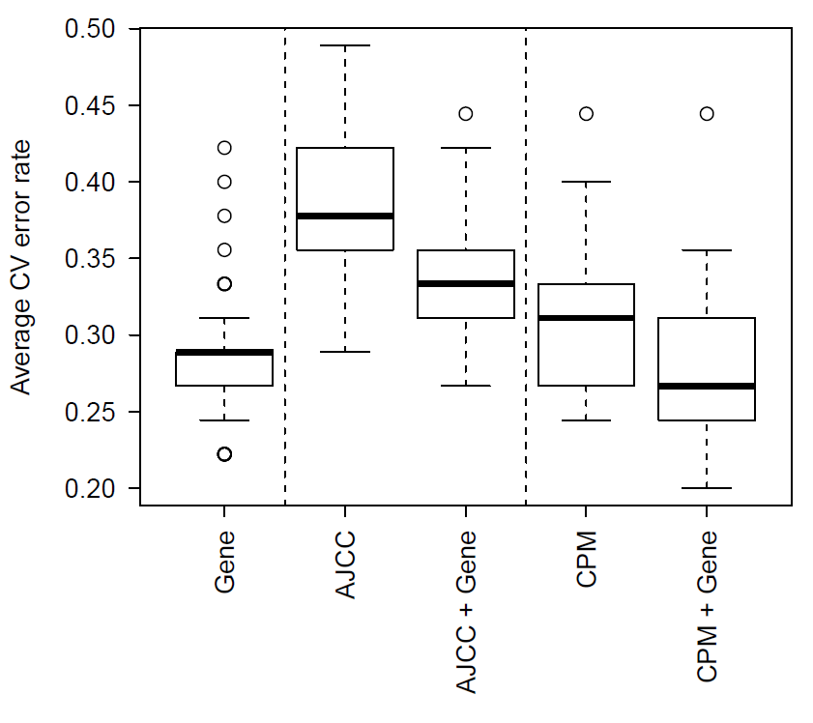
So what is wrong?
Samples may be “mislabelled” as Good Prognosis and Poor Prognosis
Classification unlikely to be through simple additive models
For example, we have variables that explain variation in some samples, but not all
Notes:
HERE: y-axis shows the average classification error rate across all patients for one of the 100 5-fold CV runs when using DLDA = Diagonal Linear Discriminant Analysis, assuming the correlation structure is diagonal (genes are not correlated) for the first boxplot and using logistic regression for AJCC using all four and CPM using variables from a outside selection (e.g. forward stepwise using AIC).
Answer interaction effects.
Hard to search for in high dimensional space.
Look for ‘simple’ interactions

Slide 27
Toy examples

Slide 28
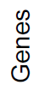

Motivating simulation example I
GP
PP
Major
Minor
Major
Minor
Notes:
n = 100,
p = 15
The color code is showing the expected expression level – for simplicity let’s assume that information in the genes has signals between -0.5 and 0.5 (normal with sd = 0.5)

Slide 29
Motivating simulation example I
GP
PP
Classification
Add some noise to the above expected expressions
Rank the genes by their ‘differential expressions’
Take the three most ‘differentially expressed’ genes
Perform a linear discriminant analysis (LDA)
Major
Minor
Major
Minor
Notes:
n = 100,
p = 15
The color code is showing the expected expression level – for simplicity let’s assume that information in the genes has signals between -0.5 and 0.5 (normal with sd = 0.5)

Slide 30
Motivating simulation example I
Majority class is better classified

Slide 31
Motivating simulation example I
GP
PP
Major
Minor
Major
Minor
Major
group
Notes:
n = 100,
p = 15
The color code is showing the expected expression level – for simplicity let’s assume that information in the genes has signals between -0.5 and 0.5 (normal with sd = 0.5)

Slide 32
Motivating simulation example I
GP
PP
Major
Minor
Major
Minor
Major
group
Minor group
Notes:
n = 100,
p = 15
The color code is showing the expected expression level – for simplicity let’s assume that information in the genes has signals between -0.5 and 0.5 (normal with sd = 0.5)

Slide 33
Motivating simulation example I
GP
PP
Major
Minor
Major
Minor
Major
group
Minor group
Classification
+ CV estimation
Classification
+ CV estimation
Notes:
n = 100,
p = 15
The color code is showing the expected expression level – for simplicity let’s assume that information in the genes has signals between -0.5 and 0.5 (normal with sd = 0.5)

Slide 34
Motivating simulation example I
Two classifiers are better than one
Major
group
Minor group
Classification
+ CV estimation
Classification
+ CV estimation
Notes:
Now, this was running classifications separately for the majority / minority group, and because we simulate, we know exactly what patient belongs to what group. Here and above we took the three most differentially expressed genes and did an LDA.

Slide 35
Motivating simulation example II
GP
PP
Major
Minor
Major
Minor
Notes:
n = 100,
p = 15
The color code is showing the expected expression level – for simplicity let’s assume that information in the genes has signals between -0.5 and 0.5 (normal with sd = 0.5)

Slide 36
Motivating simulation example II
Majority class is better classified

Slide 37
Motivating simulation example II
GP
PP
Major
Minor
Major
Minor
Notes:
n = 100,
p = 15
The color code is showing the expected expression level – for simplicity let’s assume that information in the genes has signals between -0.5 and 0.5 (normal with sd = 0.5)

Slide 38
Motivating simulation example I
GP
PP
Major
Minor
Major
Minor
Notes:
n = 100,
p = 15
The color code is showing the expected expression level – for simplicity let’s assume that information in the genes has signals between -0.5 and 0.5 (normal with sd = 0.5)

Slide 39
Patient accuracy Results from Jayawardana et al (2015; IJCR)
45 samples (excluding protein data)
GP
PP
Clinical_AJCC
CPM
mRNA
microRNA
CPM + mRNA
CPM + microRNA
Samples
Clinical_AJCC = 4 AJCC variables: 1. Ulceration, 2. thickness of the primary tumour, 3. number of metastatic nodes and 4. nodal size.
39

Slide 40
Samples that are hard to classify
resample
Patients
5-fold CV
Patients
Patients
5-fold CV
For every patient we can count how often we classify the patient incorrectly
Patient specific error
Hard vs easy samples
Genes
100 resamples
5-fold CV
Average patient
accuracy
Learning set
Testing set
Notes:
Here Black = Classified wrongly
White = Classified correctly
Let’s think about understanding why certain columns are predominantly black, white and why are some mixed: Sample = column.
Conjecture: samples that are consistently misclassified (shown in white) could belong to some minority group

Slide 41
Patient CV error as new response
Patient specific prognostic error
For every patient we
can count how often we classify the patient incorrectly
Average patient error
new response
Notes:
For each patient, going from left to right, the grey shows how often that patient was correctly classified. That is averaging out over the columns in the previous slide.

Slide 42
Regression output
y = number of correctly classified bootstrap samples under the mRNA (gene expression) platform
Design matrix X takes values from clinical variables.
Variable | Estimate | SD | t | p-value
Intercept | 0.23 | 0.76 | 2.98 | 0.005
Extranodal spread (Tum_Extranodal) | 0.37 | 0.12 | 3.22 | 0.002
Number of invasive nodes (Tum_Nodes) | -0.02 | 0.01 | -2.04 | 0.050
Notes:
Here (although we should do this differently in the future), using the average classification error as the new y (new response) we run a linear regression (which of course is not ideal and we should have worked on either transformed y’s or using nonlinear regression models) and run forward stepwise with AIC. Extranodal is dichotomous and Number of invasive nodes is integer valued 0 to 10+

Slide 43
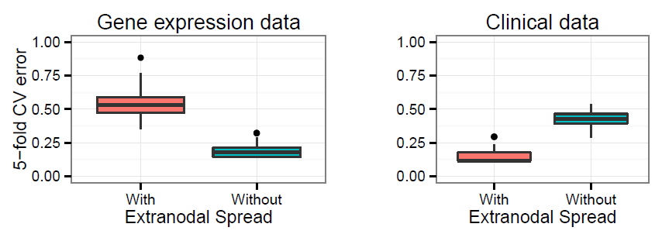
CV error’s within each “Extranodal spread” category
Notes:
Suggests no sub groups and minimal mislabelling

Slide 44
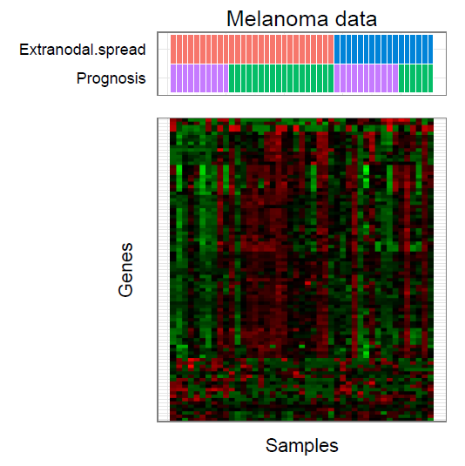

Slide 45
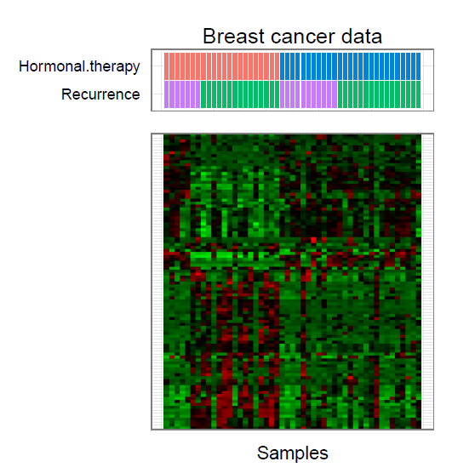
Genomic and transcriptional aberrations linked to breast cancer pathophysiologies. Chin et al (2006)

Slide 46
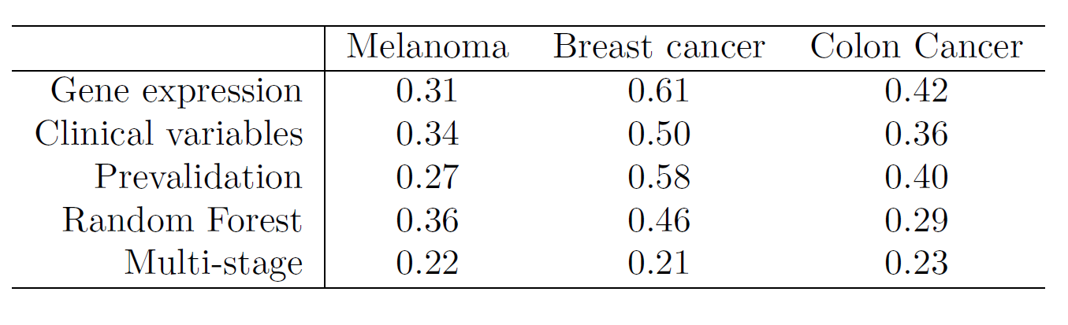
Marisa et al. (2013). Gene expression classification of colon cancer into molecular subtypes: characterization, validation, and prognostic value. Cancer Cell.
Chin et al. (2006). Genomic and transcriptional aberrations linked to breast cancer pathophysiologies. PLoS Med.

Slide 47
Where has this lead us?
Hierarchical multi stage procedure
Easy
Hard
In practice:
Use readily available CPM variables for the tumors with extranodal growth to split samples.
Perform classification based on gene expression for tumors without extranodal growth.
Clinical
variables
?
Patients
PP
GP
Use other molecular platforms?
Surgical or treatment related data?
mRNA

Slide 48
Main messages
Each data platform has its own challenges.
Additive vertical integration is not automatically better.
Error rate hunting.
Interaction effects are difficult to find when p is large.
‘Hard’ and ‘Easy’ classification helps to find interaction terms.
Good clinico-pathogical data is invaluable.

Slide 49



Interdisciplinary research
Proteomics research unit
- Ben Crossett
- Swetlana Mactier
- Richard Christopherson
University of Sydney
Mathematics and statistics
Jean Yang
Samuel Müller
Kaushala Jayawardana
Shila Ghazanfar
Dario Strbenac
Penghao Wang (CSIRO)
Anna Campain
Vivek Jayaswal
John Ormerod
Melanoma program at
MIA/WMI/RPA
Graham Mann
John Thompson
Sarah-Jane Schramm
Gulietta Pupo
Svetlana Pianova
Varsha Tembe
Lauren Haydu
Tumour bank and pathology
Richard Scolyer
Cadance Carter
Chitra De Silva
Ken Lai
James Wilmott

Slide 50
Thankyou

